Slide 1
PANIMALAR INSTITUTE OF TECHNOLOGY
DEPARTMENT OF COMPUTER SCIENCE & ENGINEERING
ANNA UNIVERSITY – FIRST REVIEW
BATCH NUMBER – B4
PROJECT TITLE : TRAFFIC VIOLATION DETECTION SYSTEM USING YOLOv7
TEAM MEMBERS :
GUIDE :
Dr. A. ANBARASA PANDIAN
JOHN KELWIN JK (211520104069)
MOHAMED YAZAR S (211520104093)
AKSHAY SREE KRISHNA M(211520104010)

Slide 2
ABSTRACT
The increasing number of bikes and cars in cities can cause high volume of traffic, and implies that traffic violations become more critical nowadays in India and also around the world.
This causes severe destruction of property and more accidents that may endanger the lives of the people. To solve the alarming problem and prevent such unfathomable consequences, traffic violation detection systems are needed.
In this paper we propose a system to automatically detect two-wheeler violations like not wearing a helmet, usage of a phone while riding, triple riding, wheeling, speeding and illegal parking for Indian road scenarios
We propose using a custom Yolo-v7 , open cv and tkinder for GUI

Slide 3
Demerits of Existing System
The existing system does not detect traffic violation like not wearing helmet, illegal parking and speeding.
Our model detect violation traffic violation like not wearing helmet, triple riding, illegal parking and speeding.

Slide 4
Proposed System
Our model detect traffic violation like not wearing helmet, triple riding, illegal parking and speeding.
Our model uses the YOLOv7 algorithm which is better than the existing system that use version 4 YOLO.

Slide 5
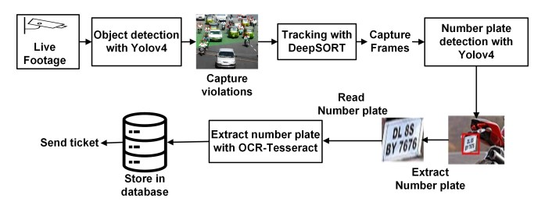
Architecture of Proposed System
DeepSort is an tracking algorithm
7
7

Slide 6
Algorithms Used
YOLO - YOLO (You Only Look Once) is an object detection Algorithm
DeepSort -DeepSORT is a tracking algorithm which tracks objects not only based on the velocity and motion of the object but also the appearance of the object.

Slide 7
DEVELOPMENT ENVIRONMENT
SOFTWARE REQUIREMENT :
Operationg System :windows 10 & 11
Language : PYTHON
IDE : MICROSOFT ‘S VISUAL STUDIO CODE
Libraries : Open CV, Tkinder(GUI)
Package Manager : PIP
HARDWARE REQUIREMENT:
CPU : Intel Core i5 @ 2.5GHz
RAM : 4GB OR above
Display : 720p Monitor or above

Slide 8
CONCLUSION
The goal of the project is to automate the traffic signal violation detection system and make it easy for the traffic police department to monitor the traffic and take action against the violated vehicle owner in a fast and efficient way.
Detecting and tracking the vehicle and their activities accurately is the main priority of the system.
Our model detect violation traffic violation like not wearing helmet, triple riding, illegal parking and speeding.

